Slide 1

Microsoft movie analysis
Leshmi Jayakumar

Slide 2
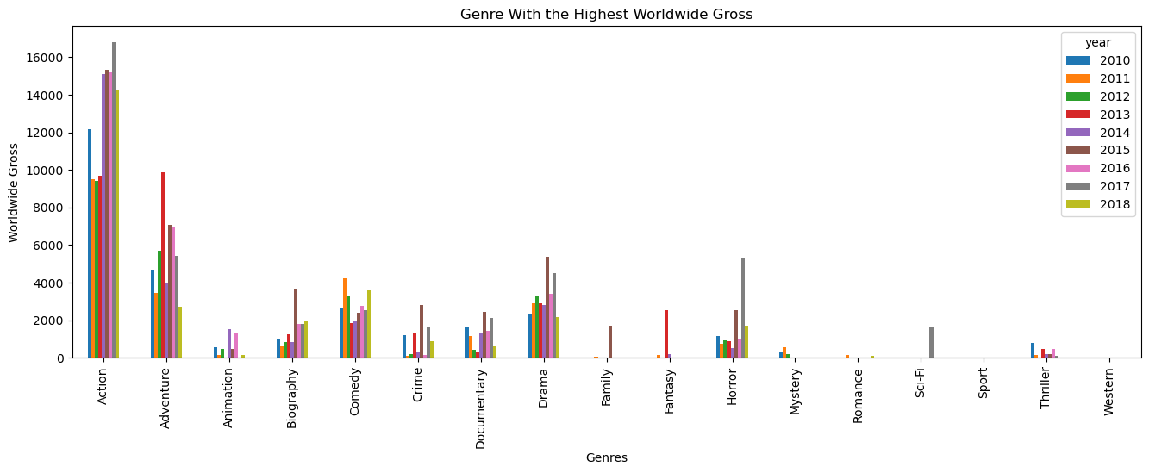
The four main genres with the highest worldwide revenue are action, adventure, comedy and drama.

Slide 3
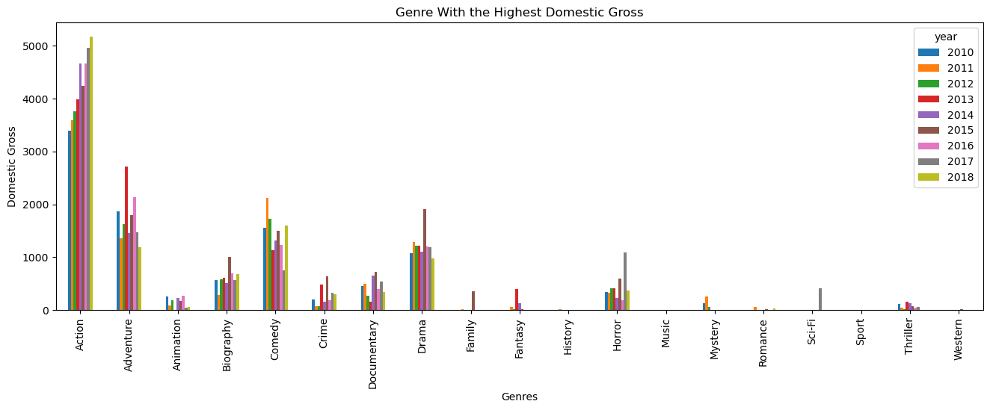
The four main genres with the highest domestic revenue are action, adventure, comedy and drama.

Slide 4
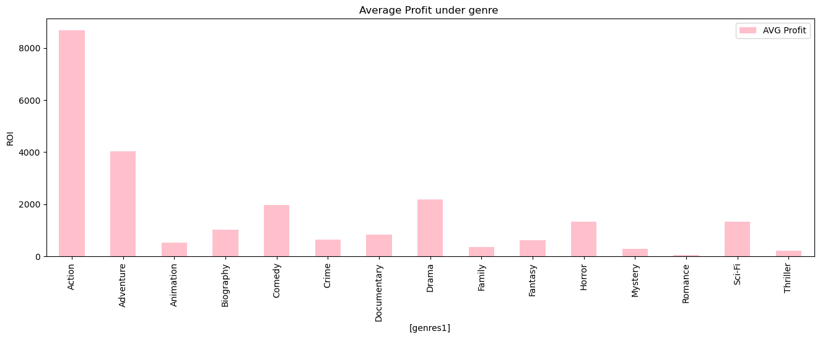
The average profit is maximum under action, adventure, drama and comedy.

Slide 5
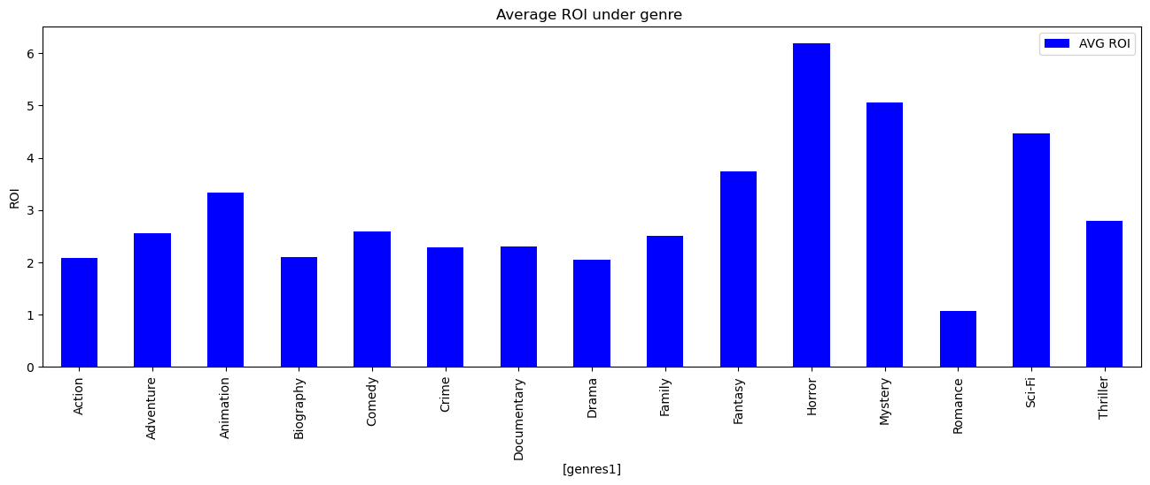
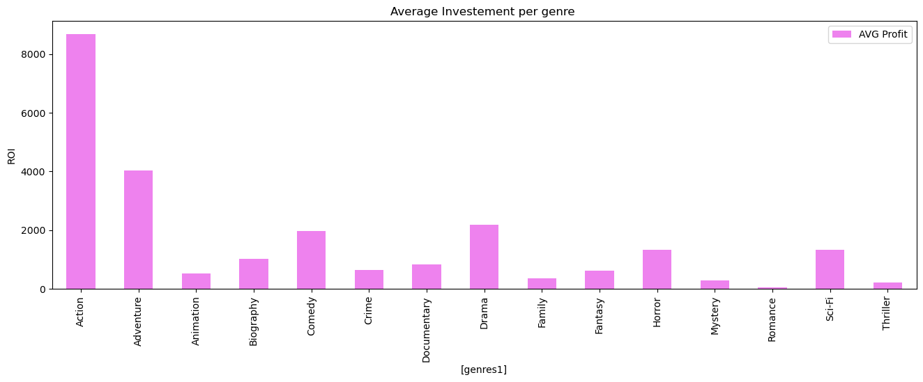
Roi which is Profit compared to the investment made is for horror, mystery, sci-fi, fantasy, Animation i.e. if you do not have big budget then it’s the above genres produce maximum Profit

Slide 6
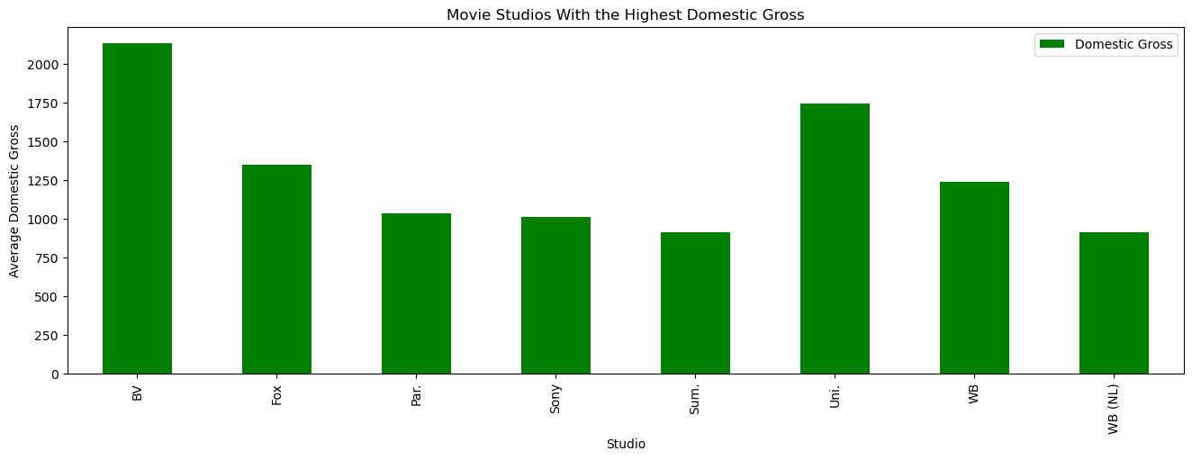
The studio which generates the highest domestic gross is BV, Uni, Fox and WB, if the movie maker is doing the movie with these studios, there is a high chance of profit.

Slide 7
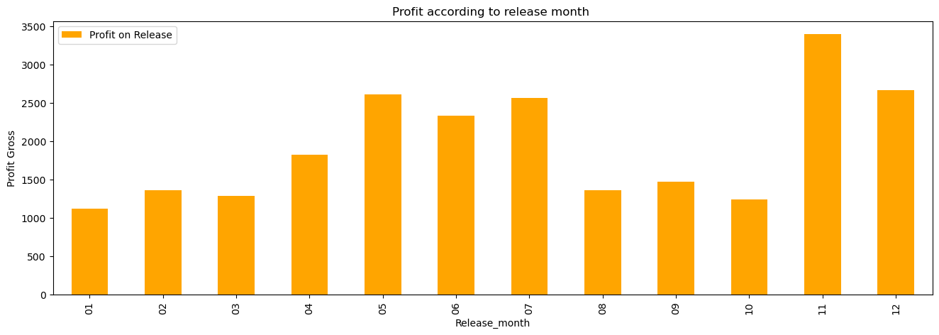
The release month which gives more profit are November, December, May and July, basically during Christmas and the School holiday seasons.
W

Slide 8
conclusion
Microsoft is highly recommended to follow the following suggestion according to my analysis:
If there is a high budget available, the best movies to produce are in the genres of action, adventure, drama and comedy respectively as this gives the maximum revenue and subsequently profit.
If there is a budget constraint, the best movies to produce movies with high ROI: are horror, mystery, sci-fi, fantasy, and animation.
Best studios to collaborate with are BV, Uni, Fox and WB as they produce high-gross movies.
Best time to release movies is during Christmas and the School holiday seasons.

